Slide 1
Conformance Refinement for Online Planning
RSMG 6
Oliver Michael Kamperis
Marco Castellani
Yongjing Wang

Slide 2
What is planning?
Formulate sequence of actions that achieve an objective:
Given an abstract world description (model),
An initial state and goal test.
Inherently difficult, the agent must reason about and optimise series of decisions and their consequences into often large future horizons.
Focusing on complex dynamic problems in/uncertain open worlds:
robot that can replace humans for completing tasks/doing jobs,
Combined navigation and manipulation type problems.
Notes:
Planning is a fundamental reasoning process that a general robot would need if its going to operate in real-world domains like retail or residential sectors, where the planner needs to be very general.
But planning is a very difficult thing to do, because the agent must reason about and optimise a series of related decisions and their consequences into large future horizons.
Generally the main problem is that the farther you look into the future, the complexity becomes exponentially worse, or at least there is some exponential term in the complexity class.
So forming long plans is a lot more challenging than sequential decision making or reactive/reflex decision making.
If we want really general and capable robot that can replace humans for completing tasks/doing jobs, than they will need these capabilities to a human extent.
There's a lot of things going on, navigation, logistics, manipulation, all sorts of special constraints, uncertainty, and a lot of demands from the humans involved.
In the complex real-world humans will expect intelligent robots to:
Formulate reasonable quality plans,
Begin execution very quickly,
Deal with plan failure or unexpected circumstances,
All this with little or no guidance from humans.

Slide 3
What do we want from a planner?
Expressive: It should be able to express complex domain dynamics.
General: It should be able to deal with a wide range of problems.
Fast: It should find solutions quickly enough to be useful.
Reasonable solutions: It is often intractable to find the optimal solution, so we can settle for something “close” but rational. A reasonable solution is one that a human might make or can at least understand.
We don’t want to tell the planner how to find a plan:
Minimise reliance on domain-specific prescriptive knowledge where possible.
Notes:
I am looking at discrete deterministic planning, and we want a system that can deal with complex system dynamics, like those we’d observe in the real world, so for example combined navigation and manipulation problems, something like a service robot working in a house.
Now obviously we can just run the problem over and over again, and run some machine learning model over it, and use that to inform our search, but what we really want is something that can be applicable for unsee problems/domains and doesn’t need to fall back on prescriptive knowledge.
Even better, we’d like something that is reasonably fast without that prescriptive knowledge, but can be speed up even more if that knowledge is available.
So we want that prescriptive knowledge to be optional, not mandatory basically.

Slide 4
Classical Planning
Generates a single finite sequence of actions (a complete plan) through some specification of a discrete deterministic dynamic system.
Usually these have a very large number of states and transitions:
Very large number of potential solutions,
Far too complex for naive exhaustive search methods.
Typical solution: Add prescriptive knowledge, e.g. a heuristic.
Guide search, by exploiting specific nature/structural characteristics of the problem.
Heuristics (under)estimate the cost or “distance” to the goal.
Efficient and scales well if a “good” heuristic exists e.g. A* pathing.
Path finding is “easy” as heuristic is based on literal distance to the goal.
Notes:
Classical planning is the simplest type of planning, and yet it is still very computationally expensive.
Finitely many states, finite length plans, actions are sequential (one per step), action effects are Markovian and instantaneous.
There are a lot of solutions because there are usually many possible paths between any two given states.
A good heuristic gives a close underestimate to the goal, to guide search towards the goal, and avoid searching through redundant parts of a planning graph or tree.
There are AI algorithms that can very efficiently solve certain planning problems, e.g. a satnav or task scheduling problems.
Literal distance to the goal means we have a clear and well define way of measuring/predicting what the cost of a particular path actually is.

Slide 5
Classical Planning
Often hard to find good heuristics for complex problems:
Often have to reduce expressiveness to make up for this.
Not always a fast and accurate way to measure “distance” to goal:
Problem may have an amorphous or elaborate structure,
May not be a way to obtain good cost estimates in reasonable time.
Might need a lot of experience from past problems instances:
Planner could learn from solutions it has found previously,
Not very elaboration tolerant and usually doesn’t generalise well.
Loss of generality if reliant on prescriptive knowledge to be tractable.
Notes:
Obtaining a good heuristic estimate might be very expensive, and thus might not actually improve performance of the planner significantly enough to make it tractable.
For complex problems it may not be feasible to find optimal plan anyway, so you might have to settle for an inadmissible heuristic anyway, because say it too expensive time-wise to obtain an admissible one.
A lot of classical planners have to significantly reduce their expressiveness to make them tractable, so they are really limited in what they can deal with.
A* is good because calculating the heuristic values is trivial, since it is just a navigation problem based on minimising the literal distance (or travel time) on a 2D plain.
You need to have some cost or utility for each action, given each state and the goal specification, this may not be easy to estimate, could include execution time and resource cost which can only be determined empirically.
Or a structure that is too complex to get a the heuristic estimate in reasonable time.
This does not mean that heuristics cannot be used for real-world problems, but there are some fundamental problems which warrant the exploration of possible alternative approaches.
Usually you have to combine multiple heuristics:
- Difficult to find a good way to combine and “switch” between them,
- Not very elaboration tolerant and usually doesn’t generalise well.
Planner loses generality if it needs prescriptive knowledge to be tractable, especially if the problem has this combination of different things going on, e.g. navigation and manipulation.

Slide 6
Refinement Planning
Generate plans over an abstraction hierarchy.
Successively refine a highly abstract classical plan down a hierarchy:
Problems are recursively divided and sub-divided into smaller subproblems,
Each action planned at abstract level becomes a subplan at bottom-level.
Divide and conquer: Easy to solve a problem if it is broken into parts:
Finds abstract plan exponentially faster than original,
Refining this to the bottom-level then exponentially faster than directly solving the original problem via classical planning.
Notes:
An alternative approach to making planning tractable.
The concept is pretty simple, generate a classical plan in a highly abstract version of the problem, so remove the details, simplify the problem as much as possible, and find an abstract solution, then refine that solution downwards across an abstraction hierarchy, until you reach bottom level, which is called the ground level, which is effectively the original problem space.
At each level in the hierarchy, the complete planning problem is divided and then sub-divided at the further lower levels into smaller subproblems.
A particular model specification can be effective for some problems not others.
If only a poor (or partial) heuristic can be found, refinement can make the problem tractable, the trade-off is that the plan might not be optimal.
It is important to note that refinement planning and heuristic planning can be combined, and in fact past refinement planners used both.
The important point is that you are reducing the reliance on prescriptive knowledge, and theoretically massively speeding up the planner
Most classical planning approaches are concerned with always finding the optimal solution, i.e. ensuring the agent always acts rationally.
However, humans are can be very effective at planning, despite that it is rarely possible to always act optimally in the real-world.
The idea behind refinement is to embrace the human ability to use abstraction to simplify planning, e.g. by ignoring problem details or making simplifying assumptions to deal with unknowns.
Usually, we can obtain reasonable solutions very quickly, even for problems which we have no encountered before or where finding the optimal solution may take prohibitively long.
Humans are reasonably good at complex planning problems, the idea of abstraction seems integral to this process, refinement is just one way to use abstraction for planning; pattern database heuristics, decompositional planning.

Slide 7
Examples of Refinement Planning by Humans
A milk-man problem:
Decide on the order to visit the houses based on a simple Euclidean distance, a “relaxed” version of the problem, last place to visit should make it easy to get home.
Over time, the milk man gets used to the route and makes better choices.
A cooking problem:
You find, or decide for yourself, some instructions, are relatively vague and general description of the sub-tasks to be completed, and the ingredients needed to complete them.
You consider the complexities later, e.g. how to crack the eggs, what pan to use, what hob to use.

Slide 8
Benefits and Problems of Refinement Planning
Doesn’t need prescriptive knowledge for search or to divide problem:
Generally very easy to define the abstraction hierarchy,
Still possible to use (partial) heuristic in refinement planning if available.
But generated plans can be arbitrarily worse:
Ignorance problem: Occurring from the lost knowledge in the abstractions.
Dependency problem: Occurring from the division of problems into subproblems that are assumed independent, this assumption almost always fails.
Inflexible technique makes this worse, each abstract action refined separately.
Not very expressive in terms of defining abstractions:
Allows only “relaxing” the classical problem, a removal of action preconditions.
Notes:
A particular model specification can be effective for some problems not others.
For certain planning problems, where these issues don’t occur, refinement planning can be orders of magnitude faster than classical planning, since the search complexity is reduce exponentially, this true even for heuristic search.
However, this issues actually almost always occur, and the latter tends to massively worsen the prior, this is partly because you can only refine one action at a time, I’ll explain this later with an example.
Another issue, is that existing planners are really limited in terms of how they define abstractions, in fact the only two true refinement planners are both limited to relaxed.

Slide 9
Answer Set Programming (ASP) based Planning
Knowledge Representation and Reasoning language:
Extremely expressive in terms of modelled descriptive knowledge,
Can deal with very large number of facts and (recursive) relations,
Can directly combine planning and diagnostics,
Excellent for representing abstraction hierarchies.
Has been limited to classical planning:
Planning is based on incremental search, similar to iterative deepening,
Becomes extremely poor when dealing with long plans,
Very difficult to represent prescriptive knowledge, heuristics non-applicable.

Slide 10
Conformance Refinement
Conformance refinement requires that a plan generated over an abstraction hierarchy remains structurally similar and achieve same effects at all levels.
An attempt to make ASP based planners general, expressive and fast.
Takes the human approach, only decide on the abstract stages of the plan initially, deals with the details later and as they emerge.
Provides better integration of planning and diagnostics.
Refines based on the effects of planned actions passed as subgoals:
More expressive abstractions, any abstract model with a state space mapping,
Allows refinement of any number of actions at once,
Allows flexible online plan generation and repair.
Notes:
Conformance refinement is effectively an attempt to revive the concept of refinement planner in ASP, plug some of the gaps in past work, make it more flexible and general overall, and support online planning, in which a plan is generated and repaired at execution.
Its conceptually similar to the refinement planners of old, but fundamentally different in practice.
Older refinement planners effectively refined each abstract action into its own subplan at the next level.
Conformance refinement doesn’t do that, it generates a brand new plan at the next level, and the only requirement is that that plan must conform with that of the previous level.
Easy to just blindly generate a sequence of actions, hard to deal with plan failure. Very tolerant to plan failure. Easy to make contingency plans. If A can no longer achieve B, look for another path to B, and then continue as planned.
Using ASP makes it much easier to support a wider range of abstract models for refinement planning.

Slide 11
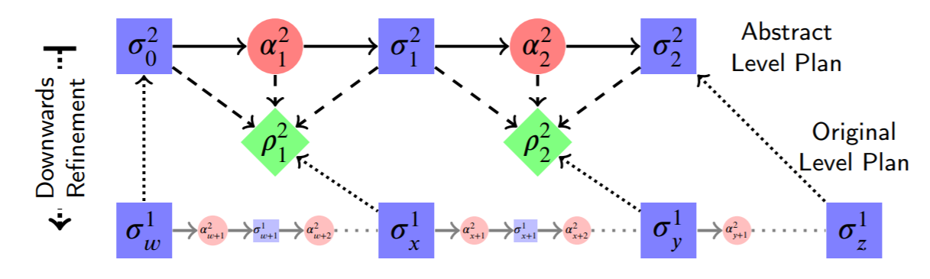
Conformance Refinement
Conformance Constraints: Restrict the search space, by guiding the planner through a sequence of abstract intermediate subgoal stages.
Problem Division: Divide the problem into smaller partial problems, defined by any contiguous subsequence of those subgoal stages.
Notes:
Conceptually very simple and easy to implement: Needs very little additional knowledge.
Ability to generate and repair plans very rapidly online: One of the most challenging abilities to enable a planner with.
Conformance is the property of achieving the same effects in the same order.

Slide 12
Supports Different Abstract Models
Relaxed Models: Remove planning constraints, e.g. preconditions of actions, to shorten plans and reduce search spaces.
Condensed Models: Remove the detailed parts/pieces of entities, combine them into abstract descriptors, reducing state space and plan length.
Discontinuous Models: Ignore inertia, e.g. a robot is simultaneously in every location it has previously been, if we can get there once, we can get there again, reduces plan lengths.
Tasking Models: Split the planning problem into a sequence of very high level tasks, allows more extensive problem division, but much more bespoke to each application domain.

Slide 13
Allows Hierarchical Plan Repair
Deals with plan failure efficiently.
Diagnostics and identification of the failed partial plan(s):
Hierarchical nature of plans (formed by sequences of partial plans) means that only the parts of plans that have failed need to be regenerated, this is called plan repair,
Repaired plans tend to get progressively worse over time,
Doesn’t need any additional knowledge to support this.
May also be possible to determine if a goal can not longer be achieved and reject it, this kind of “goal reasoning” is usually difficult to support.
Notes:
The method is entirely general.

Slide 14
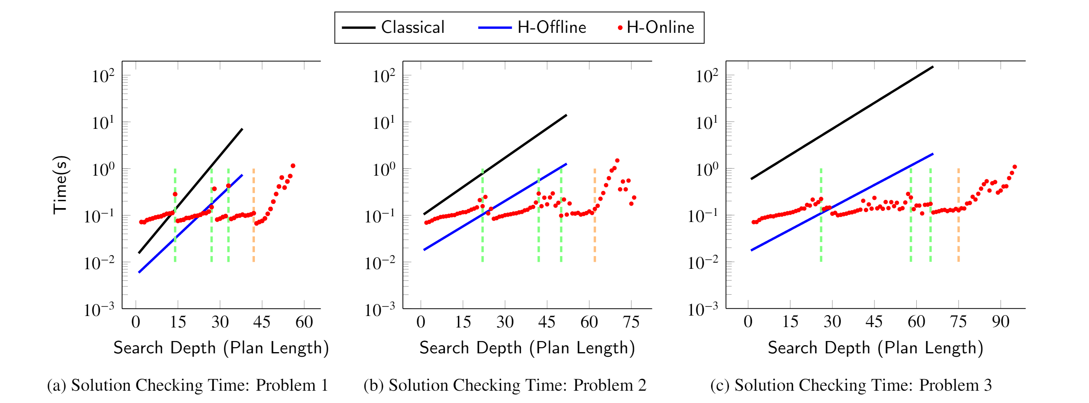
Current Results
Offline finds complete plans exponentially faster than classical.
Online yields partial plans exponentially faster than complete.
Notes:
So far, it seems the proposed approach is effective, but haven’t had a chance to compare much to other approaches.
It would be very hard to find a heuristic for this problem since it involves combined logistics and manipulation.
Not sure how well this will generalise or whether these trends will continue.
I have found that for more complex problems, e.g. with twice as many blocks, that most abstract plan took 5-6 minutes to find, whereas the ground level took only 30-40 seconds.

Slide 15
The trade-offs
Offline planning achieves the global refinement optimum:
Not subject to the dependency problem!
Still subject to ignorance problem, since all decisions made (in ignorance) at the abstract levels must be maintained in the conformance refinement.
Online planning only achieves the local refinement optimums:
Still subject to the dependency problem, hence the length of the concatenated partial plans are rarely same as the global refinement optimum,
If we had an oracle, we could find the admissible problem divisions (all partial problems are independent), but we don’t know this until it is solved.
Notes:
Plans are rarely optimal in the classical sense.
Conformance refinement actually suffers from a much wider range of issues from the ignorance problem, due to the larger variety in the abstract models it can represent.
The ignorance problem is intrinsic to abstraction planning, due to its very nature, however, when you eliminate the dependency problem, such as what happens in offline planning, the effect is very minimal, and the solutions it finds are very reasonable.
The ignorance problem is heavily exacerbated by the dependency problem.
However, the dependency problem is alleviated in online planning, because any number of actions from the plan at the previous level can be refined simultaneously.
Currently, the planner is based on a very naive way of dividing the problem, it simply splits it in half, since the test the domain I’ve been using contains there levels, you divide twice, so there are four partial problems at the ground level.

Slide 16
An example of these problems
Room composed of a set of cells.
Robot must move to correct cell to open a given door.
To open a door the robot must extend an arm.
Robot cannot move with its arms extended.
Always optimal to open right hand side door first, then the left hand side door, as this requires less movement overall.
Left door:
The robot needs to go this way first
Right door:
The robot needs to go this way second
Cell 2
Robot start
Cell 1
Cell 3

Slide 17
An example of these problems
Condensed abstract domain model used:
Cells are abstracted away in the abstract model,
Action enabling conditions are thus generalised.
Robot is now able to open a door from anywhere in the room.
Robot can open the doors in either order, without moving, because the resulting plan length is identical in both cases.
Left door:
The robot needs to go this way first
Right door:
The robot needs to go this way second
Whole Room
Notes:
The order no longer matters due to this generalisation of enabling constraints induced by the condensed domain model.

Slide 18
An example of these problems
The decision made in the abstract version of the planning problem must be maintained in the refinement to achieve conformance.
If the robot chose to open the left door first, then the plan is longer.
extend(arm) -> grasp(handle) -> actuate(door)
move_to(cell(x)) -> extend(arm) -> grasp(handle) -> actuate(door)
Left door:
The robot needs to go this way first
Right door:
The robot needs to go this way second
Cell 2
Robot start
Cell 1
Cell 3
Notes:
If we refine all three actions simultaneously, we get this plan.

Slide 19
An example of these problems
If we refine the sub-goals separately, we get this plan, where the robot does not consider that it will need to grasp the handle as the immediately next subgoal and instantly extends its arm.
extend(arm) -> grasp(handle) -> actuate(door)
extend(arm) -> retract(arm) -> move_to(cell(x)) -> extend(arm) -> grasp(handle) -> actuate(door)
Left door:
The robot needs to go this way first
Right door:
The robot needs to go this way second
Cell 2
Robot start
Cell 1
Cell 3
Notes:
If we refine them separately, we get this plan.
The robot does not consider that it will need to grasp the handle as the immediately next subgoal, if it could, then it would insert addition actions to achieve that.

Slide 20
Current Progress and Future Work
Planning systems currently work for a single robot and sequential actions.
Old implementations need to be re-added:
Concurrency and multiple robots,
Discontinuous and Tasking models,
The diagnostics system.
Work yet to do:
Various optimisations,
Plan repair algorithms,
Disassembly sequence planning case study.
Hoping to test more domains to see how well the approach generalises.

Slide 21
Case study: Disassembly Sequence Planning
Unfortunately, we’ve had very little ability to work on this.
I have a year old encoding that “works” for planning.
Even though the most abstract level is exponentially faster than the ground level, it still takes the longest time to generate for very large problems.
Idea of splitting based on very abstract task descriptions, and using bespoke abstraction mappings to define how to complete those tasks.
Identify subassemblies, work out an order to separate those subassemblies, disassembly each subassembly independently.

